Slide 1


Programming Two (csc7051)
Aidan McGowan
Enums

Slide 2
Enums
An enum is a type whose fields consist of a fixed set of constants.
Common examples include compass directions (values of NORTH, SOUTH, EAST, and WEST) and the days of the week.
Because they are constants, the names of an enum type's fields are in uppercase letters.
Notes:
public enum CommandLineArgs {
SCREEN, FILE;
}
public class TestFlags {
public static void main(String[] args) {
// check command line arguments
if (args[0].equalsIgnoreCase(CommandLineArgs.FILE.name())){
System.out.println("All output will be sent to "+CommandLineArgs.FILE);
} else if (args[0].equalsIgnoreCase(CommandLineArgs.SCREEN.name())){
System.out.println("All output will be sent to "+CommandLineArgs.SCREEN);
} else {
System.out.println("Unknown command flag");
}
}
}

Slide 3
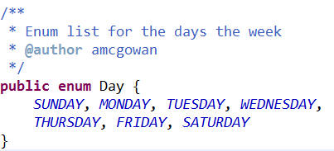
Defining an Enum
With Java, you define an enum type by using the enum keyword. For example, you would specify a days-of-the-week enum type as:

Slide 4
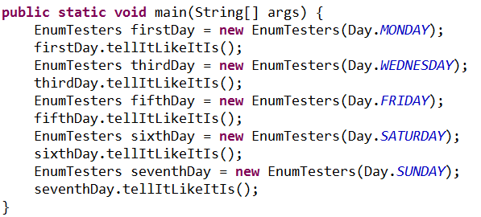

Days enum example use…

Slide 5
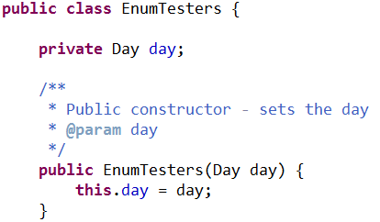
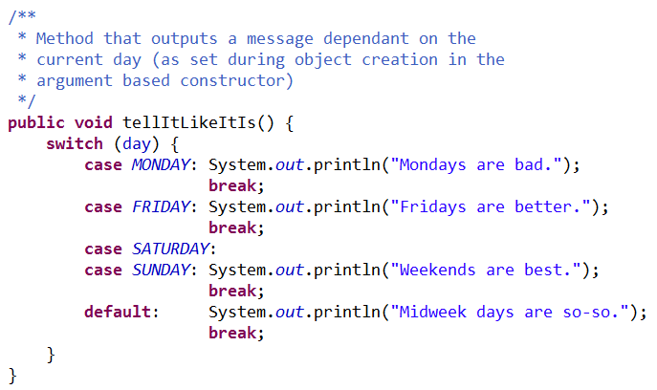
Days enum example use…

Slide 6
When to use…
You should use enum types any time you need to represent a fixed set of constants.
That includes natural enum types such as the planets in the solar system and data sets where you know all possible values at compile time—for example, the choices on a menu, command line flags, and so on.

Slide 7

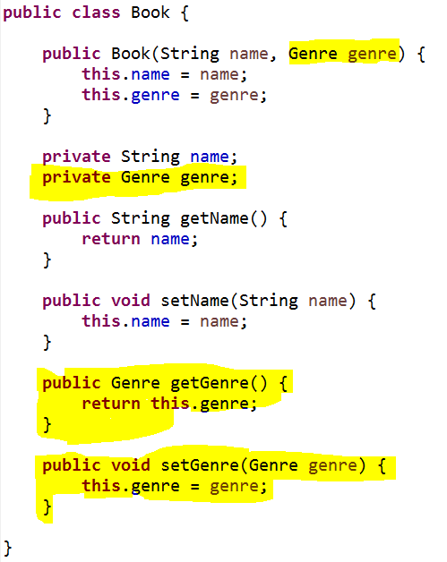
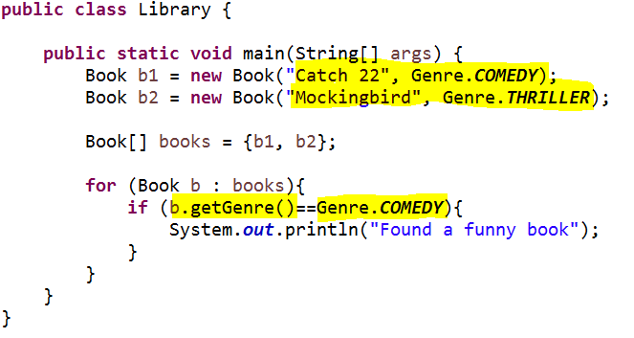
Book and genre
enum
Checking for the enum
Class that has a field that consists of the enum

Slide 8
Java Enums
Java programming language enum types are much more powerful than their counterparts in other languages.
The enum declaration defines a class (called an enum type). The enum class body can include methods and other fields.
The compiler automatically adds some special methods when it creates an enum. For example, they have a static values method that returns an array containing all of the values of the enum in the order they are declared.

Slide 9
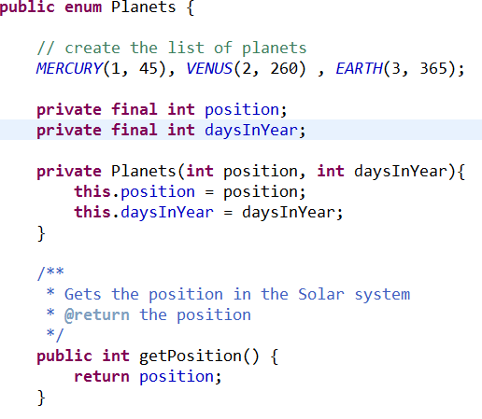
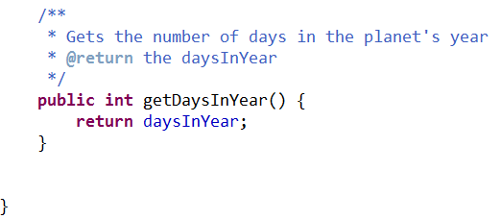

Slide 10
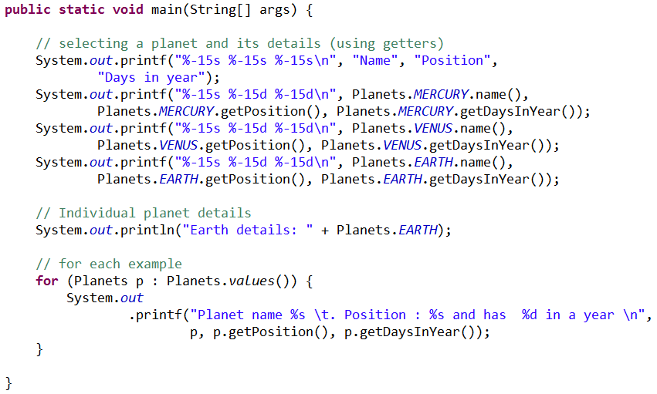
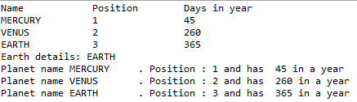
Testing out the Planet Enum

Slide 11
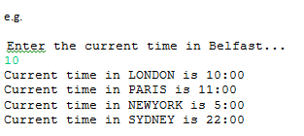
Exercise
Create an enum class that calculates the time in various cities. The user should be prompted for current time in Belfast (hours only). The output should be the current time in all the cities represented in the enum cities.
City | Time adjustment (GMT)
Dublin | 0
London | 0
New York | -5
Paris | +1
Sydney | +12
Notes:
package TimeChecker;
public enum CityTimes {
DUBLIN(0), LONDON(0), NEW_YORK(-5), PARIS(1), SYDNEY(12);
private int offSet;
private CityTimes(int hour){
this.setOffSet(hour);
}
private void setOffSet(int hour) {
this.offSet = hour;
}
public int getOffSet() {
return offSet;
}
}
_____________________________________________________________
package TimeChecker;
public class TestTimes {
public static void main(String[] args) {
int hour = 22;
int convert = 0;
for (CityTimes cities : CityTimes.values()) {
switch (cities) {
case DUBLIN:
case LONDON:
System.out.println(cities.name() + " "
+ (cities.getOffSet() + hour) + ":00");
break;
case PARIS:
if (hour == 23) {
convert = 0;
System.out
.println(cities.name() + " 0" + (convert) + ":00");
} else {
System.out.println(cities.name() + " "
+ (cities.getOffSet() + hour) + ":00");
}
break;
case NEW_YORK:
if ((hour >= 0) && (hour<=4)) {
System.out.println(cities.name() + " "
+ (cities.getOffSet() + hour +24) + ":00");
} else {
System.out.println(cities.name() + " "
+ (cities.getOffSet() + hour) + ":00");
}
break;
case SYDNEY:
if ((hour > 12) && (hour<=23)) {
System.out.println(cities.name() + " "
+ (cities.getOffSet() + hour -24) + ":00");
} else {
System.out.println(cities.name() + " "
+ (cities.getOffSet() + hour) + ":00");
}
break;
default:
System.out.println("Unknown city");
break;
}
}
}
}

